Slide 1
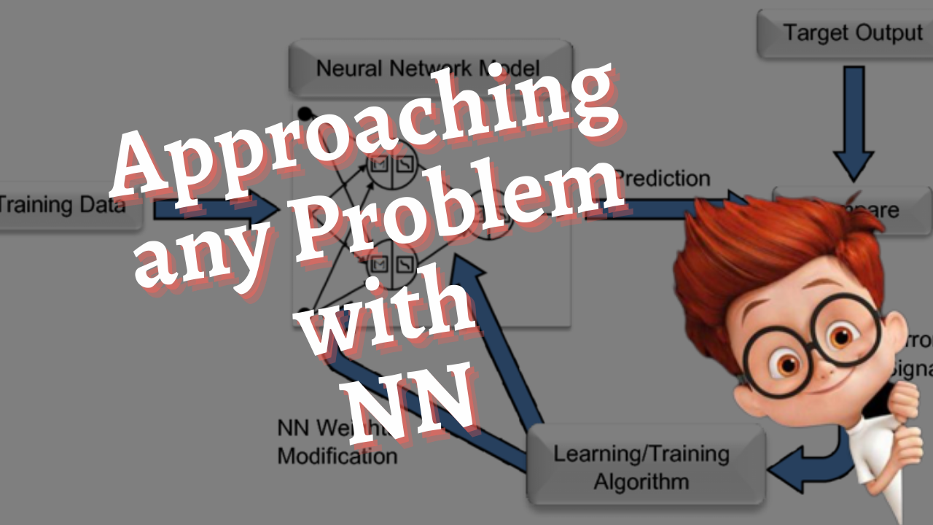

Slide 2
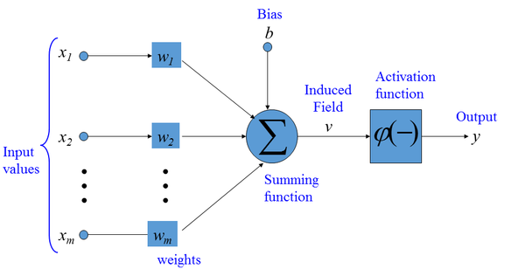
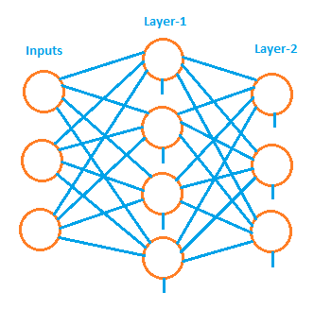
Recap
Coding a Neuron
Components of a Neural Network
Coding a Neural Network
Activation Functions

Slide 3
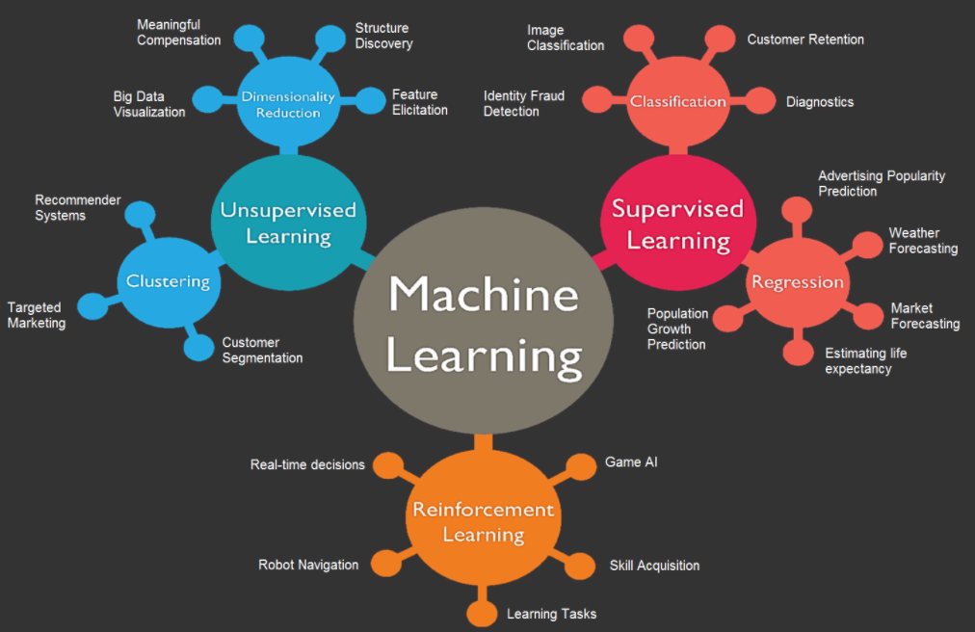

Slide 4
Classification Regression
Output - Category (Decision)
Output - Probability Score
Image Classification (cats vs dogs)
Spam vs Non-spam
Loan Sanction or Eligibility
Sentiment Analysis
Anomaly Detection
Output - Quantity or Value
Output - Real Number
Weather Forecasting
Market Forecasting
Population growth estimate
Sales Prediction
Car Price Prediction

Slide 5
Loan Eligibility
S.No | Age | Salary (LPA) | Debts (Lakhs) | Eligiblity
1 | 25 | 24 | 10 | No
2 | 27 | 18 | 2 | Yes
3 | 35 | 35 | 5 | Yes
4 | 46 | 40 | 5 | Yes
5 | 57 | 12 | 15 | No
6 | 21 | 15 | 0 | Yes
7 | 48 | 32 | 2 | Yes
8 | 37 | 25 | 5 | Yes
9 | 33 | 27 | 8 | Yes
10 | 31 | 18 | 0 | Yes
Input Features:
Age, Salary, Debts
Target or Label:
Eligibility

Slide 6


Model
R
R
R
R
R
R
0.7
0
R
R
Loss (L)
Parameters:
Weights & Biases
R
R
Gradient Descent
25 | 24 | 10
Optimizer
No

Slide 7
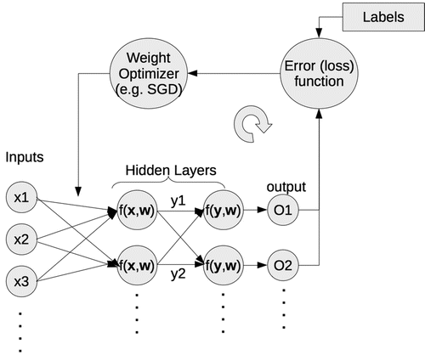
Typical Setup
Data
Model
Parameters
Loss/Error Function
Optimizer

